Slide 1
Capstone project vehicle sales data
Presented by:
Ragam.siva ganesh
Sasi institute of technology &engineering
Information technology

Slide 2
Outline
#Problem statement
#Proposed System/solution
#System development approach
#Algorithm & deployment
#Result
#Conclusion
#Future scope
#references

Slide 3
Problem statement
.
construct a model to predict the fair market value of a used car based on its features and historical sales data. Analysis the factors influencing car prices such as brand,model,year,mileage,condition,features.

Slide 4

Proposed solution
The proposed system aims to address the challenges of Data Quality Issues,Data Representations,modeling, Interpretation and validation.The solution will consists of following components.
1. Understanding Market Trends and Customer Preferences (Libraries: pandas, matplotlib, seaborn):Descriptive Statistics: Use pandas.describe() to summarize numerical features like price, mileage, and year.Calculate summary statistics for categorical features (e.g., number of cars per brand).Data Visualization: Create time series plots with matplotlib or seaborn to visualize trends in sales volume, average price, and popular features over time.

Slide 5
Generate bar charts or pie charts to compare sales across car segments (sedans, SUVs, trucks) or brands.For advanced visualizations, consider libraries like plotly for interactive dashboards.Customer Segmentation:Employ scikit-learn for clustering algorithms (K-Means, hierarchical clustering) to segment customers based on their demographics, car preferences, and purchase history.Analyze the characteristics of each customer segment using pandas understand their preference. Predict sales volume (regression) segment customers for targeted marketing(clustering) identify key factors influencing sales(feature importance analysis)

Slide 6
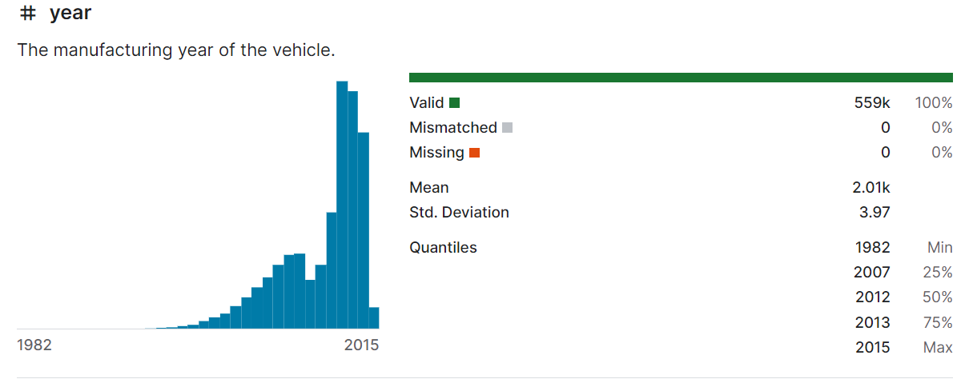
SELECTING VISUAL AIDS
ENHANCING YOUR PRESENTATION

Slide 7
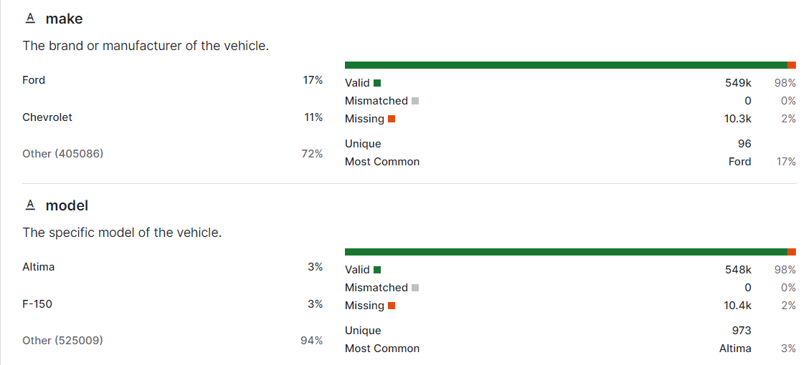

Slide 8
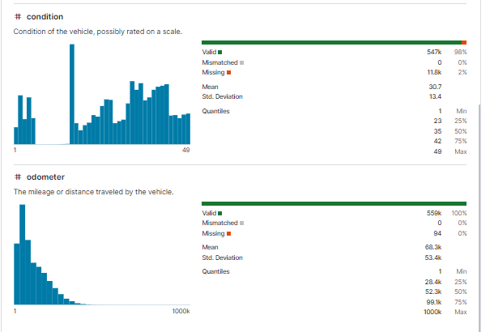

Slide 9
Sysyem approach
→ Internal sales databases
→ Market research reports
→Publicly available datasets (Kaggle, government data)
Consider data relevance to your goals and potential licensing requirements.
→Extract or download data in a suitable format (CSV, Excel, etc.)
→Ensure secure access methods and data privacy regulations are followed.
→Use Python libraries like Pandas and NumPy for data manipulation and analysis.
→Create a structured approach to explore data distributions, relationships, and potential trends.
.

Slide 10
Algorithm & dePLOYment
SALES PREDICTION
Regression Techniques:
Linear Regression: Simple and interpretable, suitable for linear relationships between features and sales.
Decision Trees/Random Forests: More robust to non-linear relationships and handle complex interactions between features.
DEPLOYMENT:
.API Integration: Integrate the prediction model into
an existing sales system to generate real-time sales
forecasts.
.INTERACTIVE Dashboard: a dashboard where
users can input parameter Creaters and view predicted sales
for different scenarios.

Slide 11
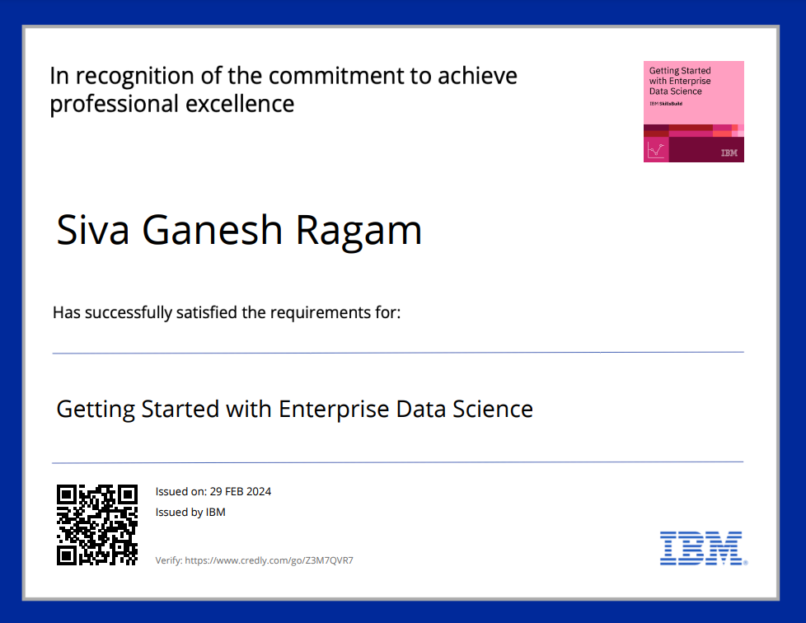
Certificate 1

Slide 12

Certificate 2

Slide 13
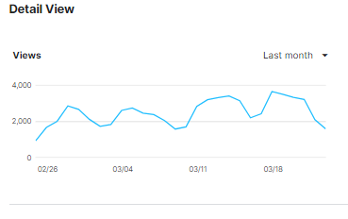
RESULT
Improved sales forecasting accuracy (percentage improvement)
Identification of key factors influencing sales volume (e.g., price, features, brand)
Metrics related to customer segmentation (number of segments identified, size of each segment)
Improved targeting effectiveness in marketing campaigns (e.g., click-through rates, conversion rates)

Slide 14
CONCLUSION: Summarize the key takeaways from the analysis and how they contribute to achieving your project goals. Discuss the limitations of the analysis (e.g., data quality issues, limitations of chosen algorithms). Highlight the impact of the findings on various business aspects (sales, marketing, product development). Suggest potential areas for further investigation or improvement in future analysis. For example, you could suggest collecting additional data points or exploring more advanced machine learning models.

Slide 15
References
https://www.kaggle.com/
https://docs.jupyter.org/en/latest/
https://github.com/danawoodruff/Car-Sales-Analysis/tree/main/Car_sales_Data
file:///C:/Users/sivag/OneDrive/Documents/Getting_Started_with_Enterprise_Data_Science_Badge20240229-45-hl25ge.pdf
file:///C:/Users/sivag/OneDrive/Documents/Journey_to_Cloud__Envisioning_Your_Solution_Badge20240229-29-6ozcz1.pdf

Slide 16


